Slide 1
REPORT ON OFFICE SUPPLY ANALYSIS

Slide 2
EXECUTIVE SUMMARY
This report covers the financial performance of an office supply of biro, A4 paper, Notepad, markers, pencil and stapler across Lagos, Osun, Ondo, Ogun and Oyo state within 5 segments of the office. The analysis has been done to enable the organization make decisions on the growth and declines across each of the segments and states with respect to the products.

Slide 3
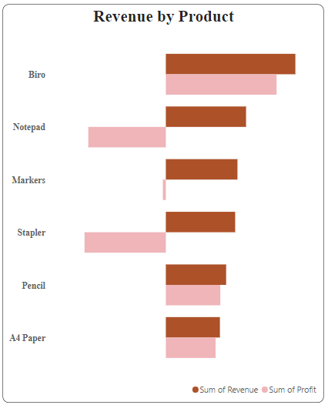
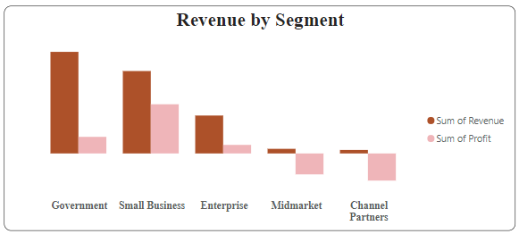
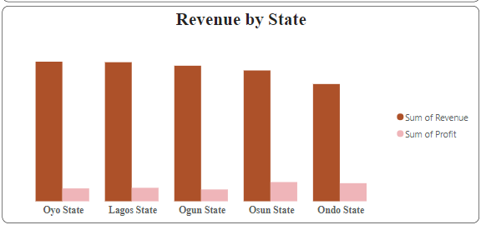
KEY FINDINGS
Government had the highest sum of revenue which was ₦53,541,263.80 while channel partners was the lowest with ₦1,833,890.46. Sum of Revenue and Sum of Profit diverged the most when the Segment was Government which accounted for 44.17% of sum of revenue.
Oyo state had the highest sum of revenue ﻿At ₦25,551,372.24, while Ondo state had the lowest sum at ₦21,460,055.03 Sum of Revenue and Sum of Profit diverged the most when the State was Oyo State, Oyo State accounted for 21.08% of Sum of Revenue.
Biro had the highest sum of revenue of ₦33,765,351.45 and accounted for 27.85% of sum of revenue , while A4 Paper had the lowest Sum of Revenue of ₦14,094,162.80.﻿

Slide 4
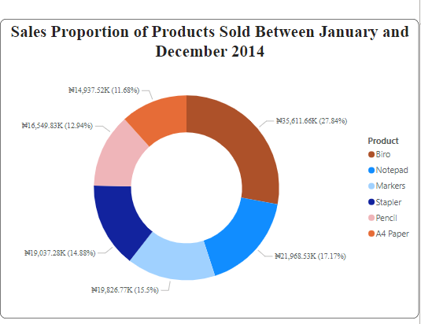
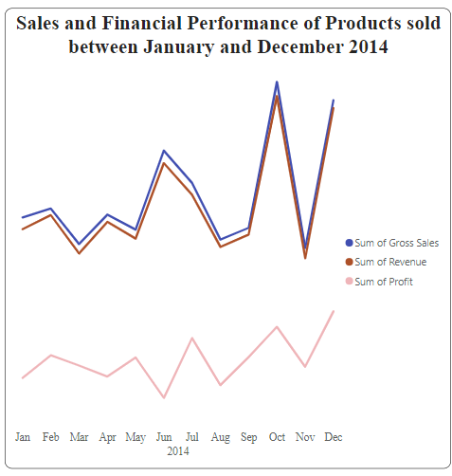
KEY FINDINGS CONTD.
Between may and June 2014 there was a notable drop in profit from ₦1,095,451.26 to -₦699,340.14 and the highest growth of gross sales was recorded between September and October with ₦6,845,317 to ₦13,313,424.
The financial performance across the year ranged from ₦7,307,403.50 to ₦12,508,268 for gross sales, ₦6,783,266.68 to ₦12,160,865.64 for the revenue and ₦185,747.49 to ₦3, 140,831.71 respectively.
The sales proportion shows that biro accounted for 27.84% of the gross sales.

Slide 5
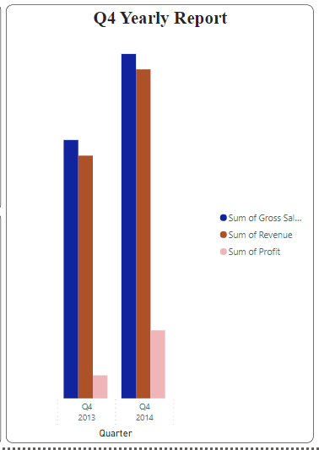
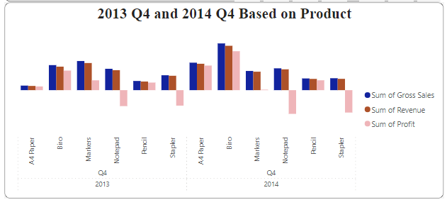
KEY FINDINGS CONTD.
In the 4th quarter of the year 2013 loss was incurred on notepad with -₦3,647,096.88 and stapler with -₦3,540,716.98 and there was a noticeable rise in loss in the year 2014 on notepad with -₦5,426,608.19 and stapler with -₦5,121,942.05
In the 4th quarter of year 2014 the total revenue and profit rose to ₦30,345,870.91 for the revenue and ₦6,275,318.98 profit compared to the year 2013 with ₦22,388,809.66 as the revenue and ₦2,124,782.03 as the profit.

Slide 6
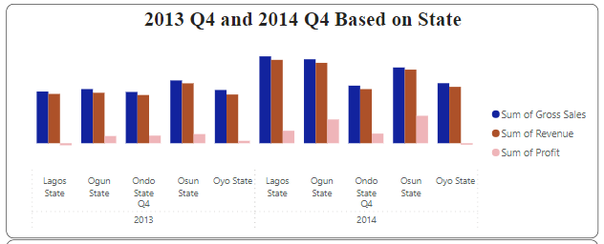
KEY FINDINGS CONTD.
In the 4th quarter of the year 2013 Osun state had the highest gross sales, revenue and profit of ₦798,970.20 while Lagos state experienced a loss of -₦179,786.16. In contrast, in the year 2014 at the same quarter the highest gross sales, revenue and profit of ₦1,089,292.61 was recorded at Lagos state while Oyo state had lowest record of profit at -₦127,790.72

Slide 7
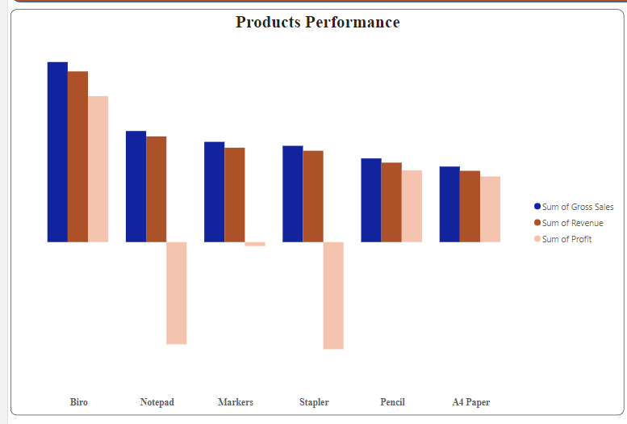
KEY FINDINGS CONTD.
The key products which are the drivers of performance are biro, pencil and A4 paper.
Markers, notepad and stapler should be discontinued due to poor outcomes over the years.

Slide 8
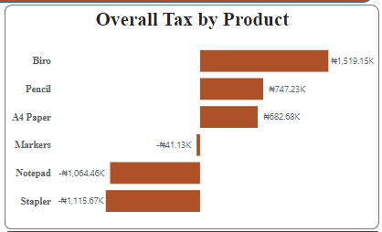
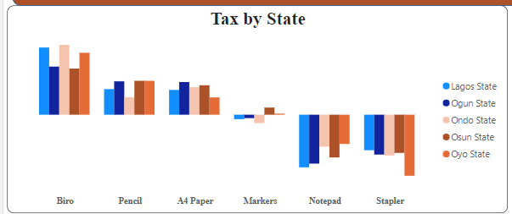
KEY FINDINGS CONTD.
Product with the highest paid tax is biro
Product with the highest paid tax across the different states is biro

Slide 9
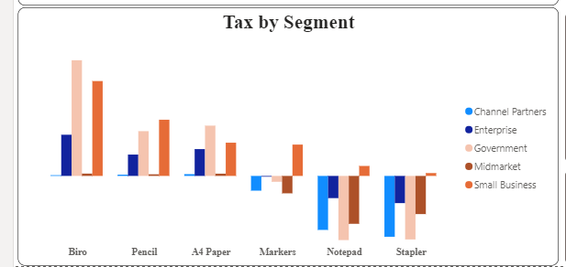
KEY FINDINGS CONTD.
Enterprise, small business government and mid market paid highest tax on biro while channel partners paid highest tax on A4 paper.

Slide 10
RECOMMENDATIONS
The organization should strategize on how to improve on markers, notepad and stapler which losses has been incurred. They can increase the product quality, review the price, channel there product in states and segments that have there target audience, improve on the distribution channel and general market strategy.
products that has been the key performance should be maintained and enhanced as well.
The organization can partner with tax experts that offer affordable tax services to enable them reduce the cost of tax paid on products such as biro and A4 paper which has the highest paid tax without reducing the quality of service.

Slide 11
CONCLUSIONS
In conclusion, the analysis done showed detailed insight on the financial performance of the products based on segment and state, it shows the product that has contributed significantly to the growth in financial performance across states and segments.
Products that are the key drivers of performance has been viewed based on how they contributed to the financial revenue and profit, as well as the ones that needs to be reviewed for better improvement so as to contribute to the growth and profitability of the organization.
Proper decision on future improvement and sustainability of the organization.

Slide 12


